Slide 1
Assignment 1
Group 1:
Amisha Aggarwal (2019016) Gitansh Raj Satija (2019241) Pritish Wadhwa (2019440) Yash Tanwar (2019130)
(Classification using Modified Decision Trees)

Slide 2
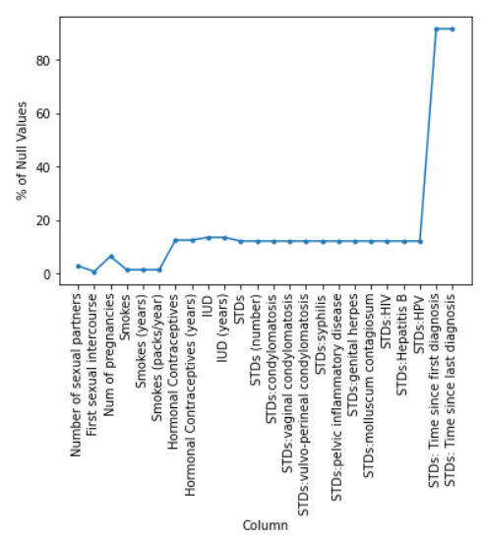
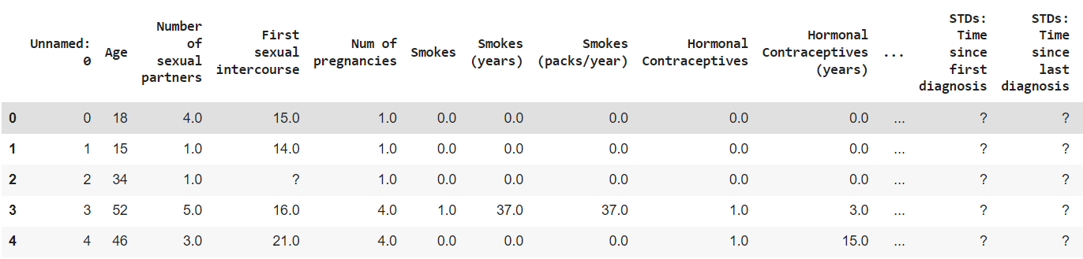
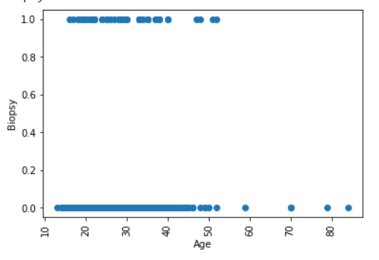
Preprocessing (Dataset 1)
Figure 2
Shape of dataset 1 is (858, 37)
Many null values were represented by a ‘?’ entry. Replaced them with ‘NaN’
Firstly, The columns ['STDs:AIDS', 'STDs:cervical condylomatosis'] had either ‘?’ or 0, so removed them.
Columns ['STDs: Time since first diagnosis', 'STDs: Time since last diagnosis'] had in excess of 90% values as null (Figure 2), so removed them.
There are very few samples with age more than 55, so they are outliers in the dataset (Figure 3), so removed them as well.
After analyzing the heatmaps, we decided to remove columns whose correlation score >= 0.8. So removed 5 columns: ['STDs', 'STDs (number)', 'Dx:HPV', 'STDs:AIDS' , 'STDs:vulvo-perineal condylomatosis']
Figure 3

Slide 3
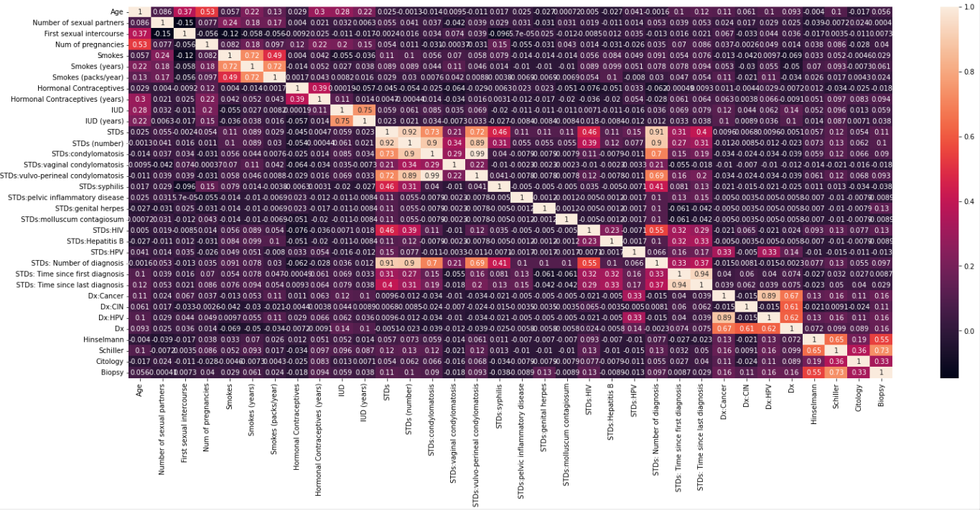
Heatmap for Dataset 1

Slide 4
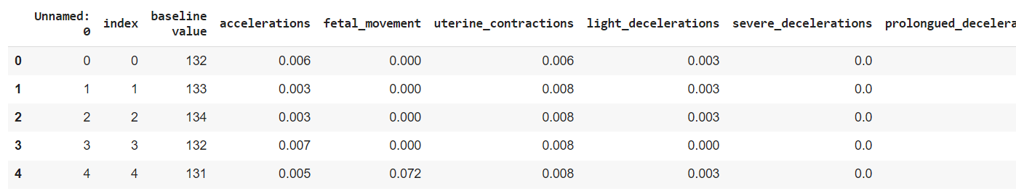
Preprocessing (Dataset 2)
Combined both the CSVs present in the drive folder to create a single data file.
Shape of dataset 2 is (2126, 24)
On studying each of the column separately, these were the conditions using which the outliers were detected and removed:
baseline value<120 & fetal_health =3
fetal_movement>0.1 & fetal_health=2
mean_value_of_short_term_variability>5
mean_value_of_long_term_variability>25 & fetal_health=2
mean_value_of_long_term_variability>30
histogram_max>220
histogram_number_of_zeroes>6
After analyzing the heatmaps, we decided to remove columns whose correlation score >= 0.8. So removed 2 columns: ['histogram_mean', 'histogram_median']

Slide 5
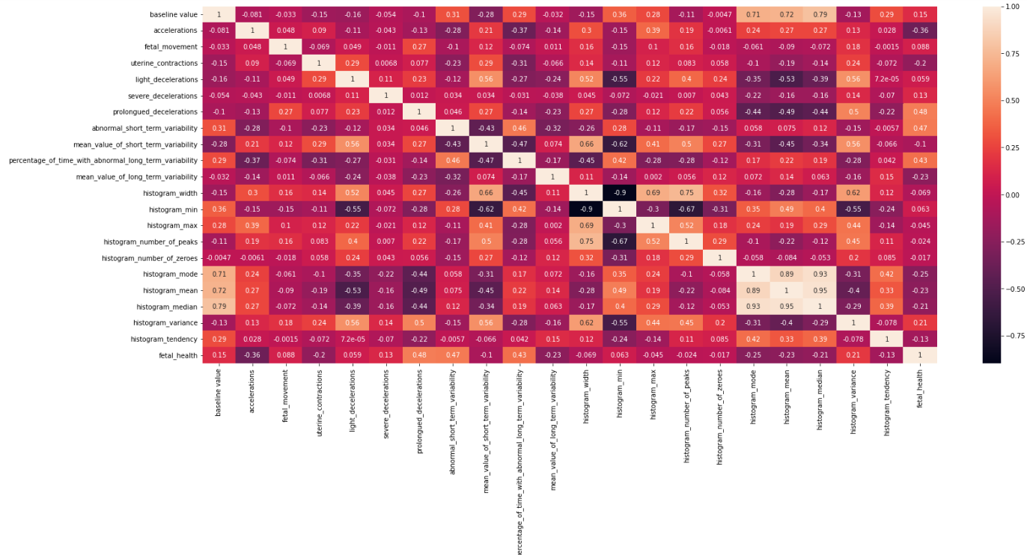
Heatmap for Dataset 2

Slide 6
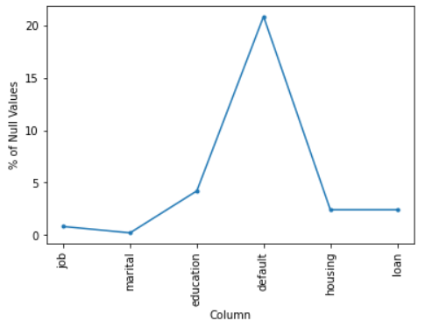
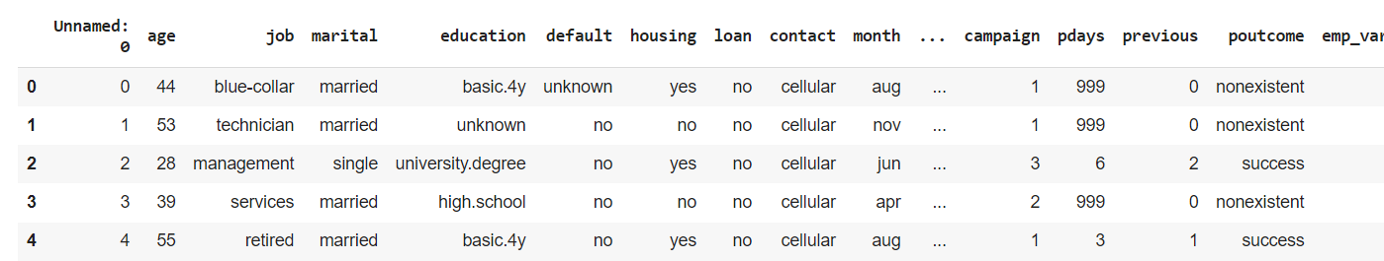
Preprocessing (Dataset 3)
Shape of dataset 3 is (41188, 22)
Many columns contained data in form of strings, so one hot-encoded them.
Many null values were represented by a ‘unknown’ entry. Replaced them with ‘NaN’
Plotted the % of null values in columns, but not as significant as Dataset 1, so didn’t remove them.
Lastly, on studying each of the column separately, these were the conditions using which the outliers were detected and removed:
campaign>22 & y=1
age>95
duration>=2500
euribor3m>3.0 & y=1 & euribor3m<4
campaign>35
After analyzing the heatmaps, we decided to remove columns whose correlation score >= 0.8. So removed 2 columns: ['emp_var_rate', 'euribor3m']

Slide 7
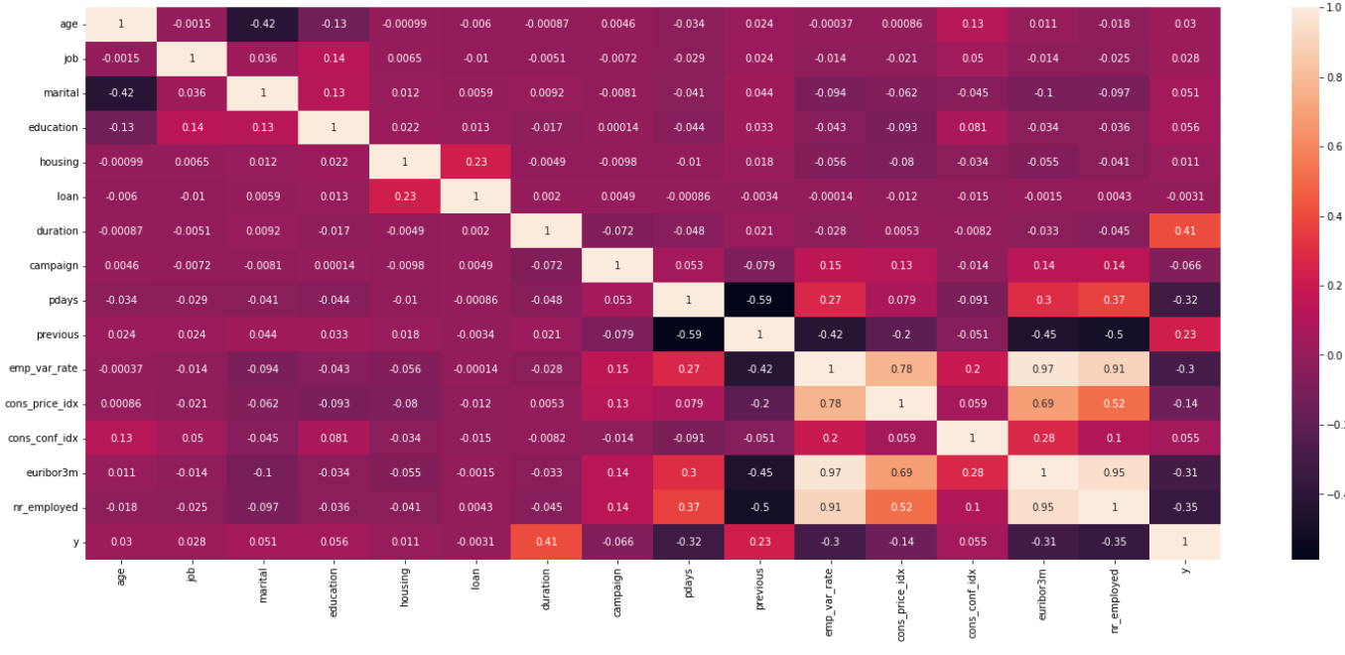
Heatmap for Dataset 3

Slide 8
Modeling Steps
The implementation of HDTree was used to modify the existing decision tree. Using HDTree, three different splitting functions were introduced, which made sure that the splitting at each node was done using logistic regression instead of any other method. The functions were:
LogisticRegressionSingleSplit: This makes sure that for the categorical data, the splitting takes place according to the rules obtained from logistic regression.
TwoQuantileRangeSplit: This makes sure that for the continuous data, the splitting takes place according to the rules obtained from logistic regression.
LogisticRegressionDoubleCategorySplit: This makes sure that for the 2 attribute splitting, the splitting takes place according to the rules obtained from logistic regression.
Splitting is done on the basis of the coefficient and the intercept obtained from the logistic regression model. For the 2nd dataset, which had more than 2 targets, we followed a one versus rest approach where we ran the model three times representing the targets ‘1 vs rest’, ‘2 vs rest’, ‘3 vs rest’. We found the class probabilities for each of the samples in these cases and finally assigned the class with maximum probability for each sample.

Slide 9
RESULTS

Slide 10
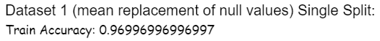
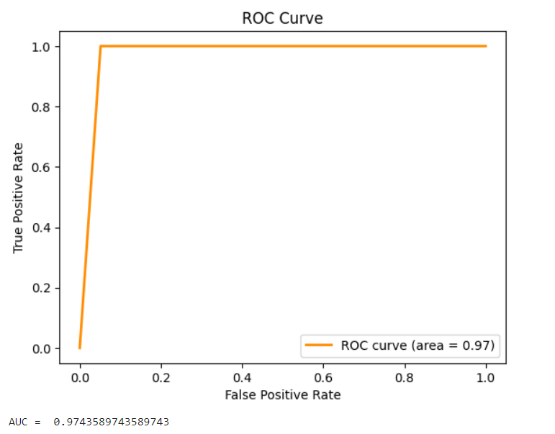
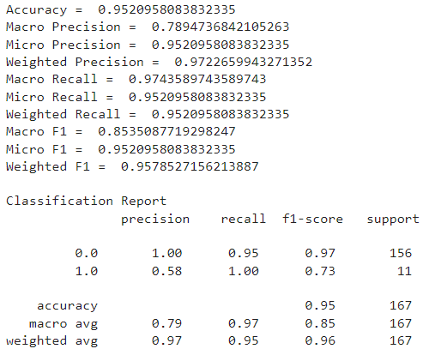
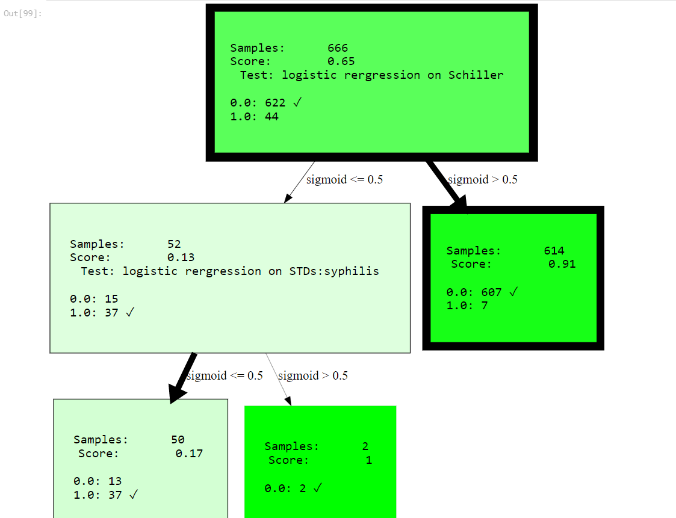
Dataset 1 (Mean Replacement of Null Values): Single Split
On Test Statistics:
Tree Visualization:

Slide 11
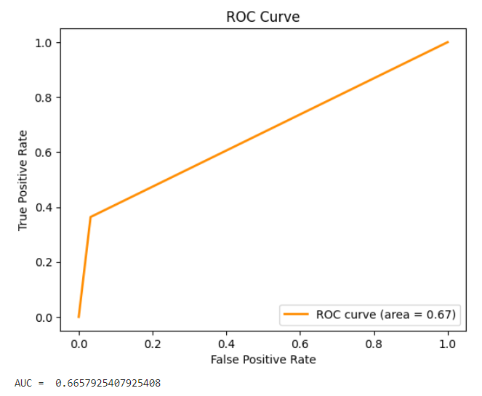
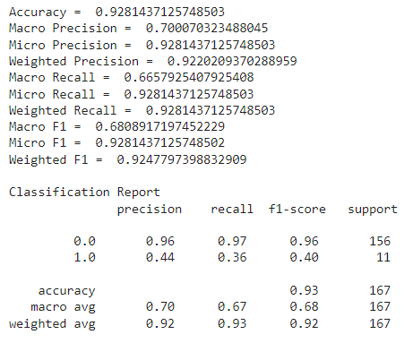
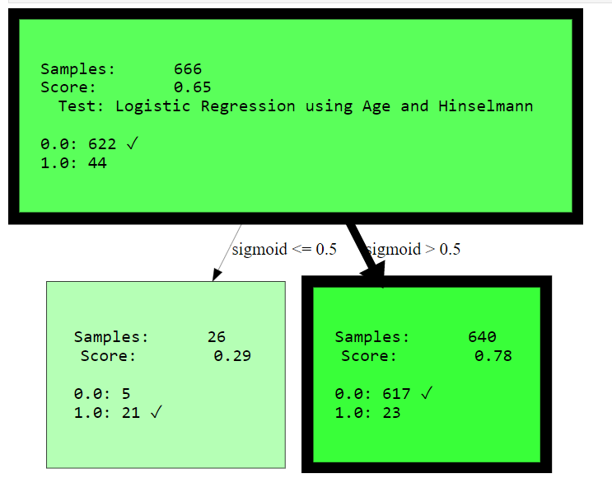
Dataset 1 (Mean Replacement of Null Values): Pairwise Split
Train Accuracy: 0.9579579579579579
Test Results:
Tree Visualization:

Slide 12
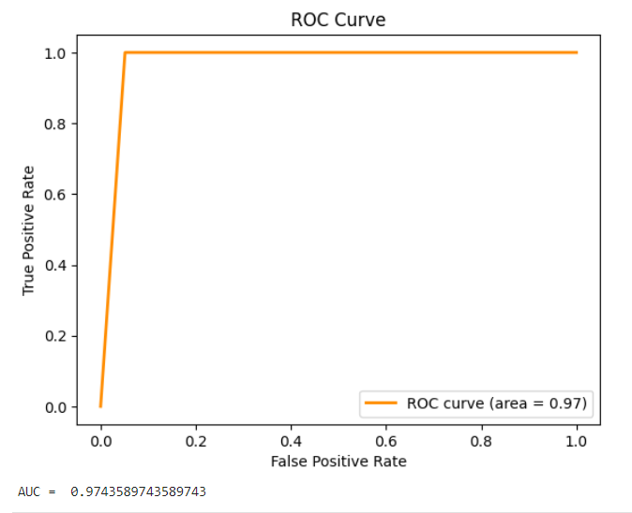
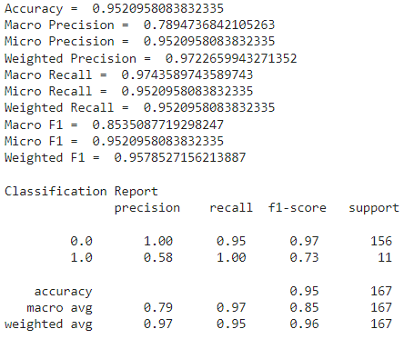
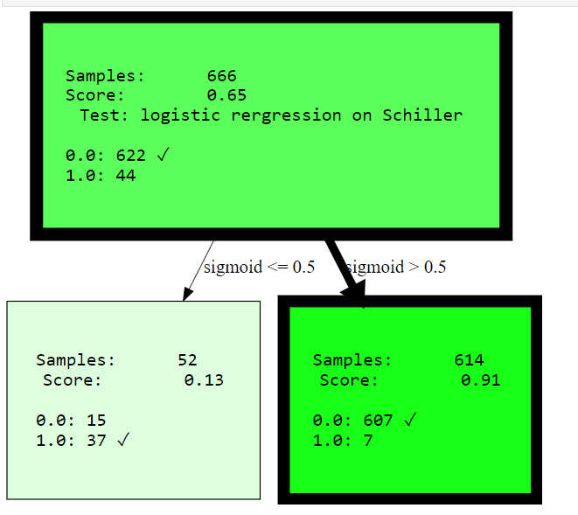
Dataset 1 (median replacement of null values): Single Split
Train Accuracy: 0.9669669669669
Test Results:
Tree Visualization:

Slide 13
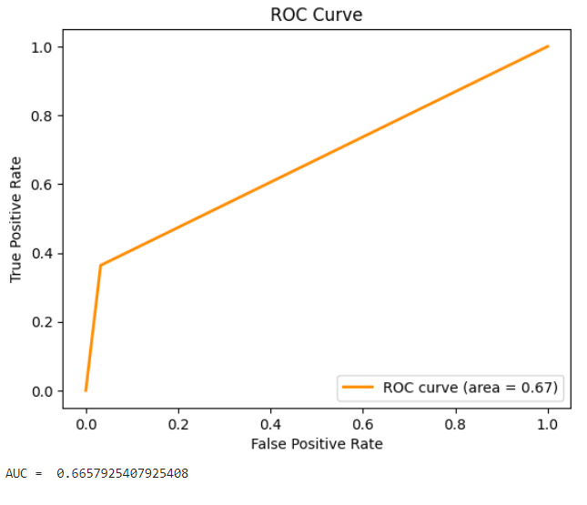
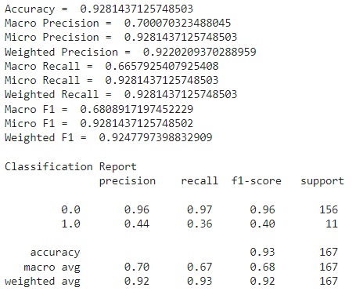
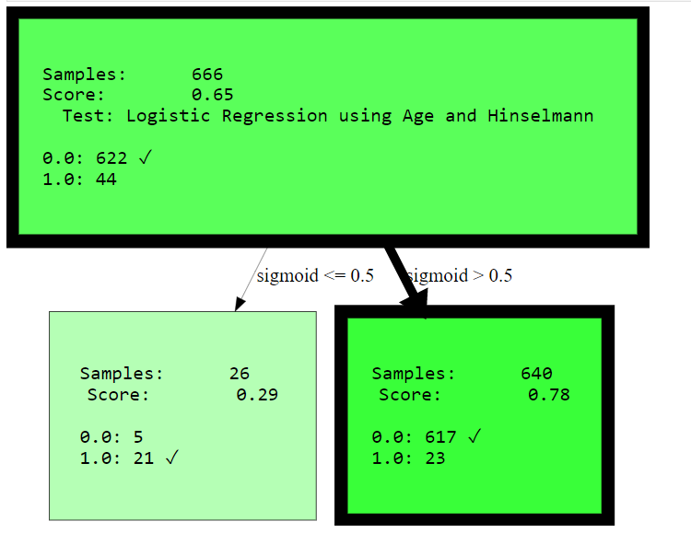
Dataset 1 (Median Replacement of Null Values): Pairwise Split
Train Accuracy: 0.957957957957
Test Results:
Tree Visualization:

Slide 14
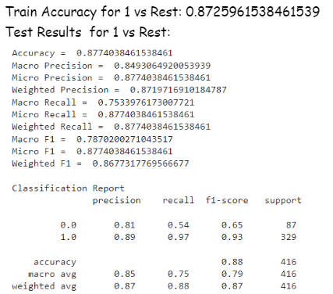
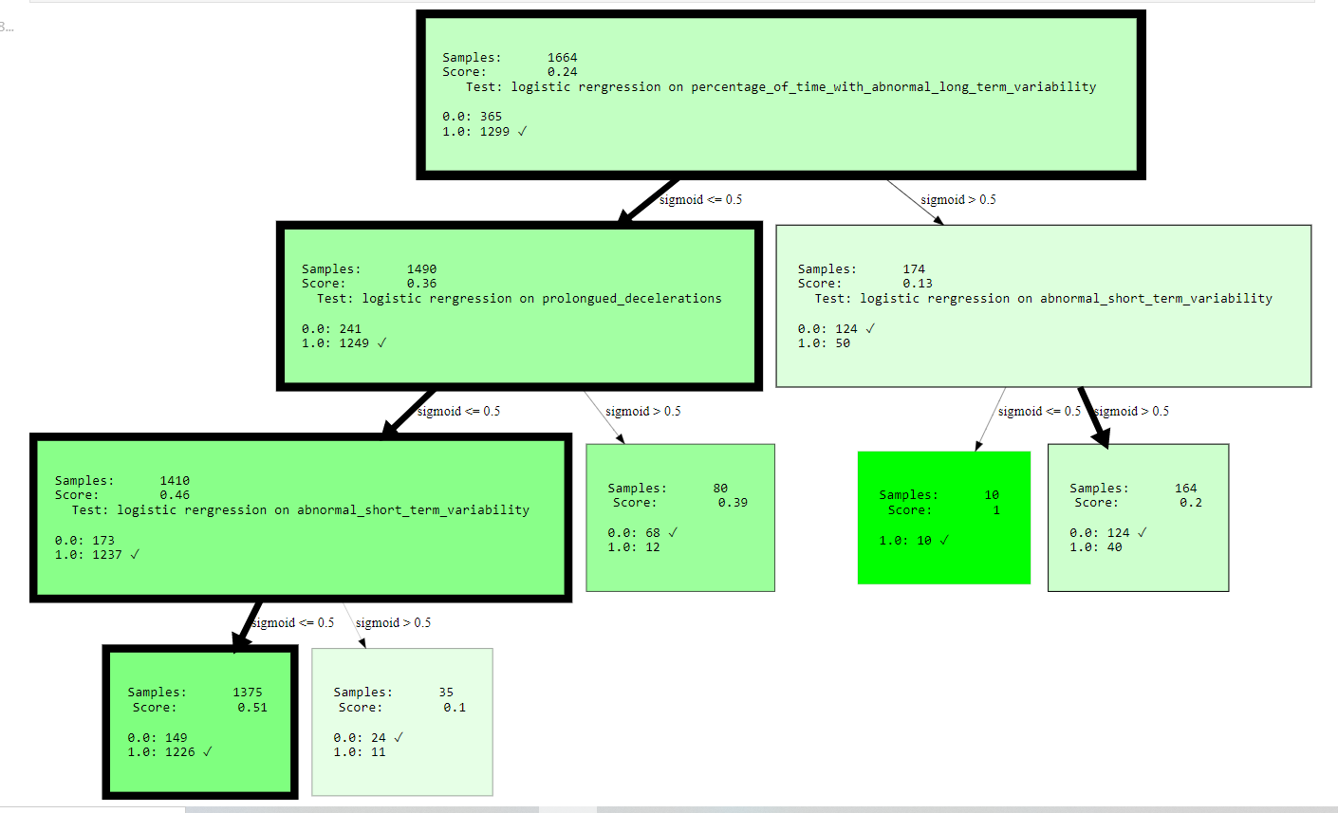
Dataset 2 (1 vs Rest): Single Split
Tree Visualization:

Slide 15
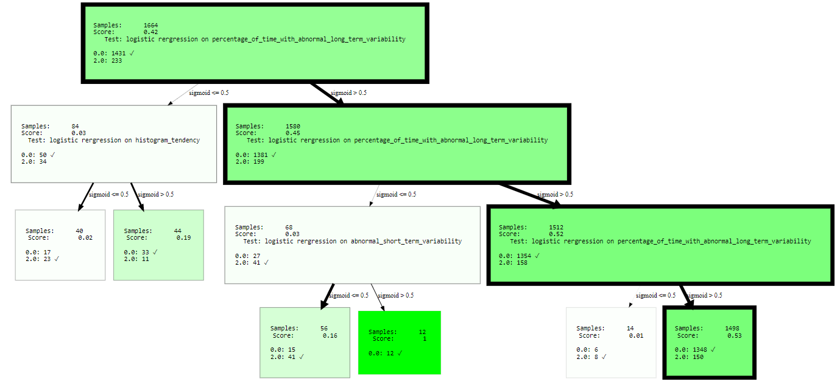
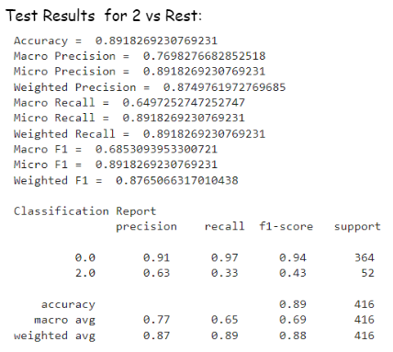
Dataset 2 (2 vs Rest): Single Split
Train Accuracy for 2 vs Rest: 0.8804086538461539
Tree Visualization:

Slide 16
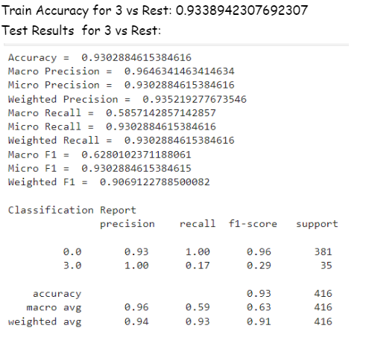
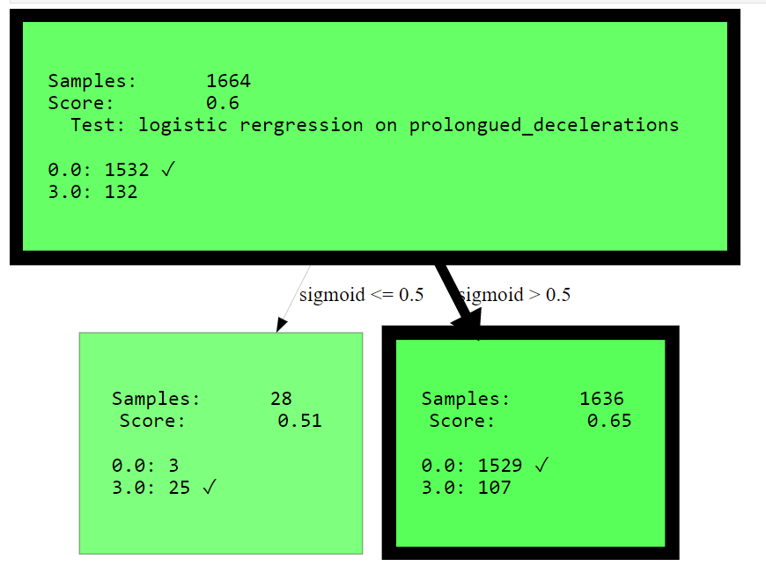
Dataset 2 (3 vs Rest): Single Split
Tree Visualization:

Slide 17
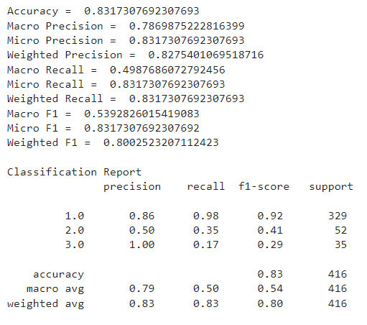
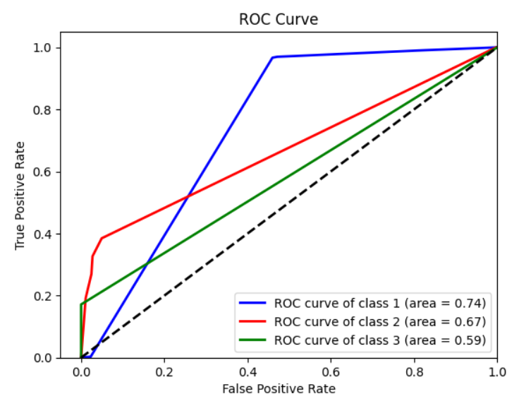
Dataset 2: Single Split (Final Results)

Slide 18
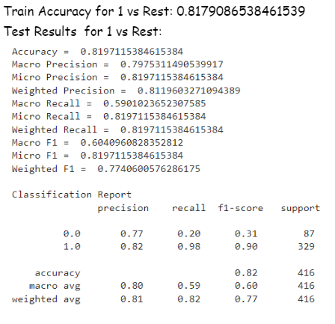
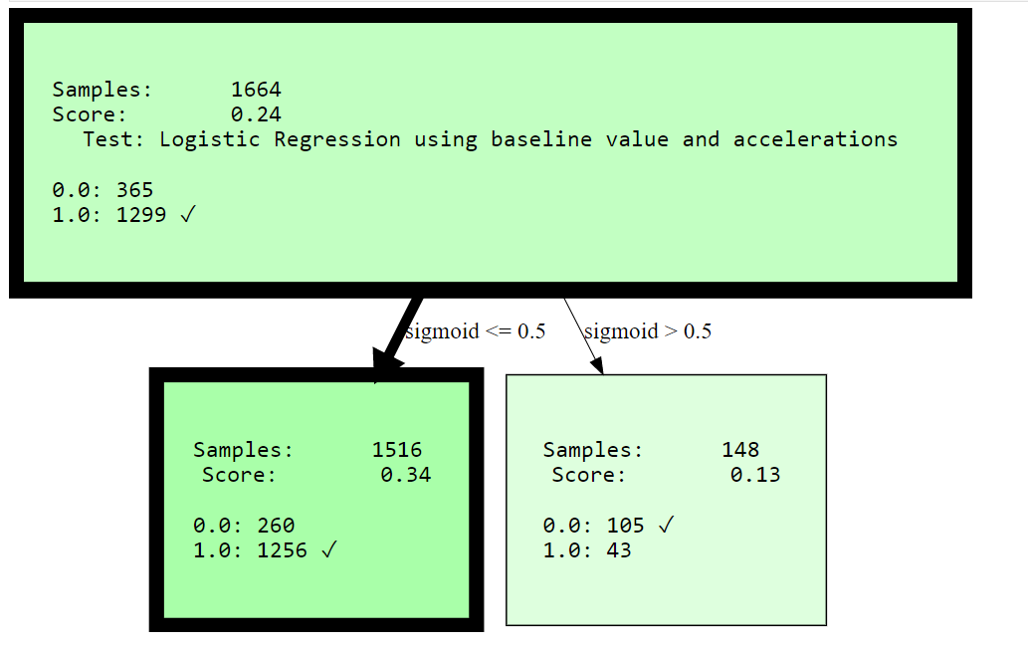
Dataset 2 (1 vs Rest): Pairwise Split
Tree Visualization:

Slide 19
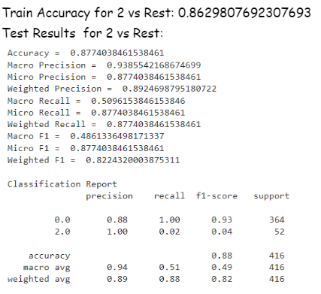
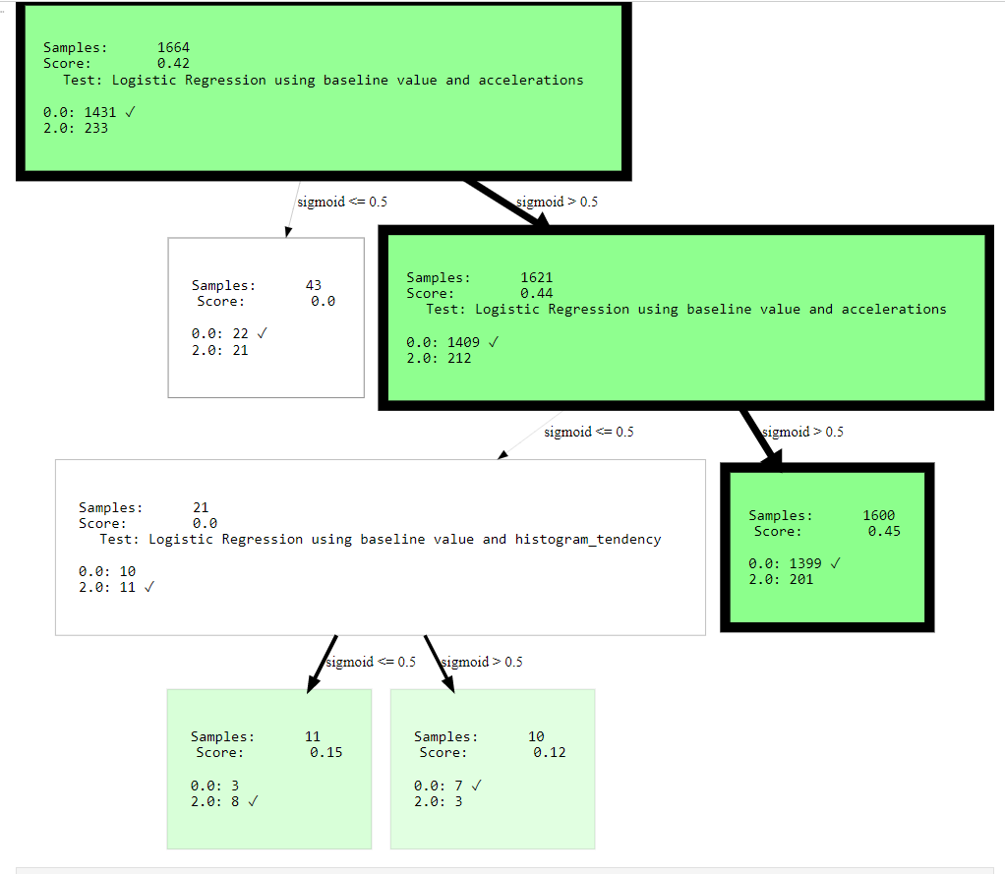
Dataset 2 (2 vs Rest): Pairwise Split
Tree Visualization:

Slide 20
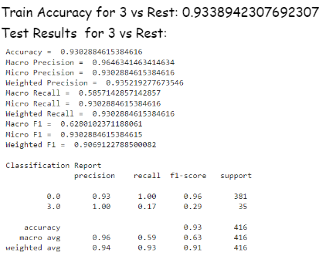
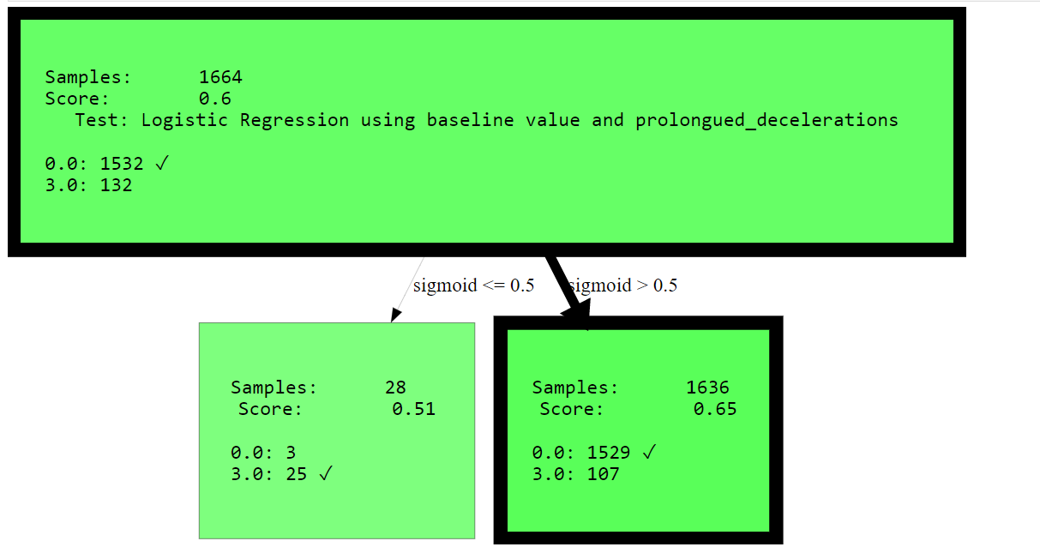
Dataset 2 (3 vs Rest): Pairwise Split
Tree Visualization:

Slide 21
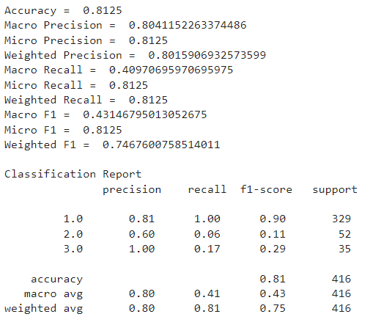
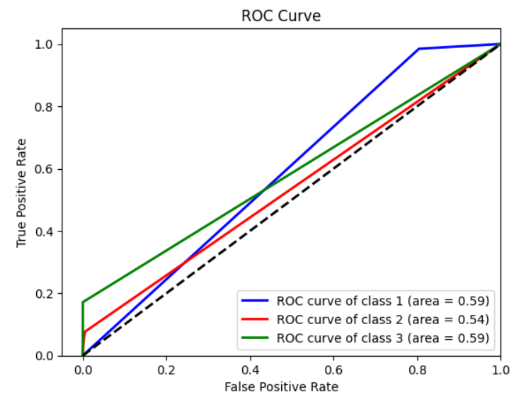
Dataset 2: Pairwise Split (Final Results)
Final Metrics on test data:

Slide 22
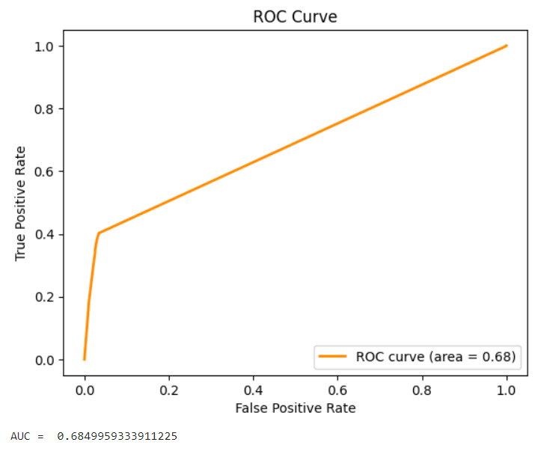
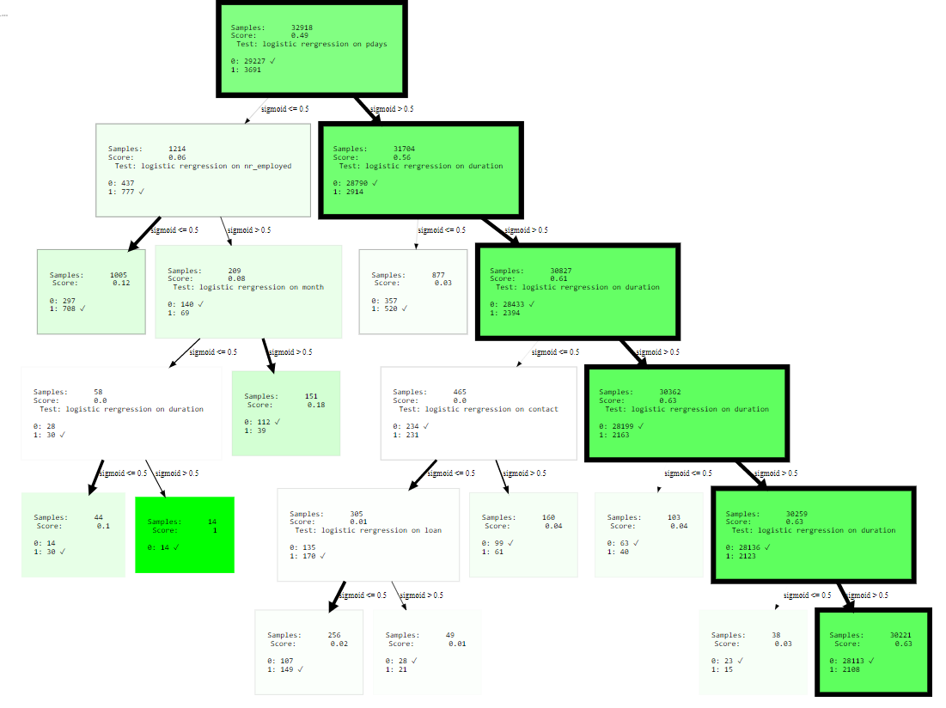
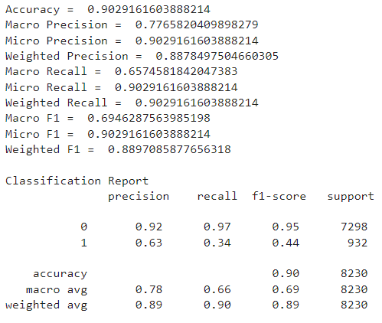
Dataset 3 (numerical conversion of categorical features): Single Split
Tree Visualization:
Train Accuracy: 0.9070721185977277
Test Results:

Slide 23
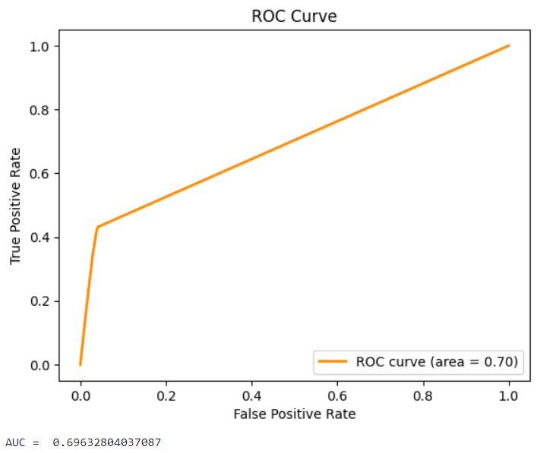
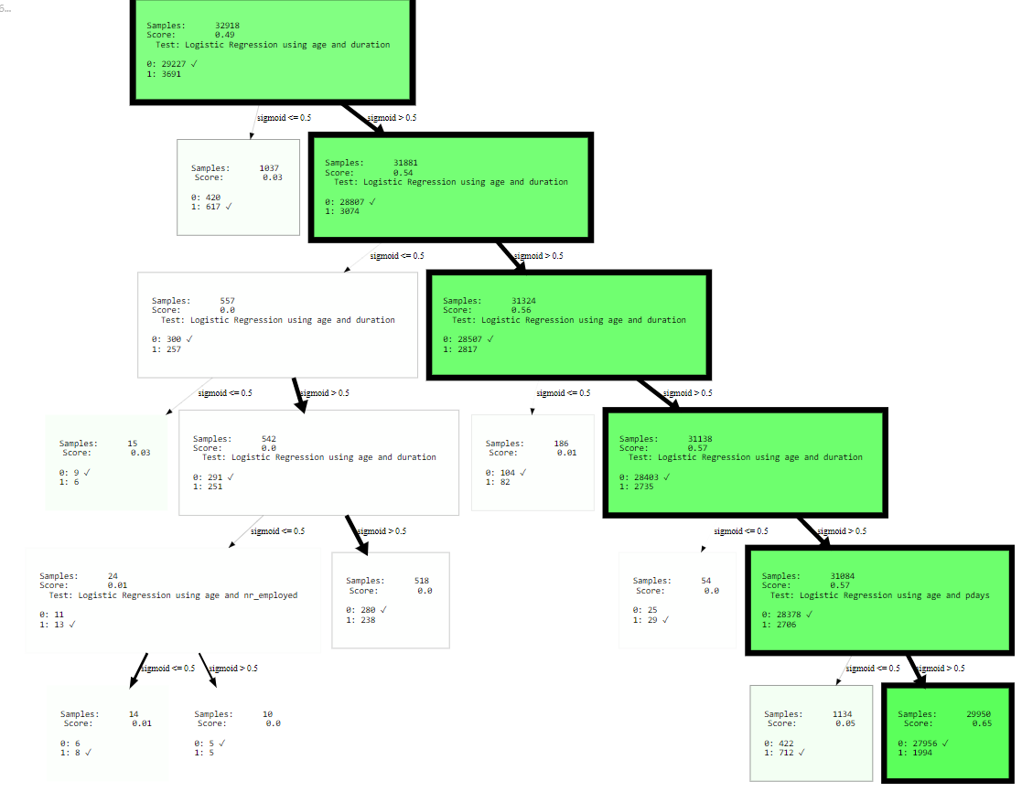
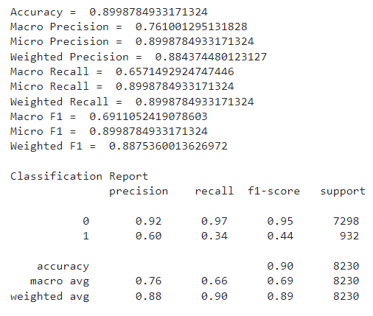
Dataset 3 (numerical conversion of categorical features): Pairwise Split
Train Accuracy: 0.9028495048301841
Test Results:
Tree Visualization:

Slide 24
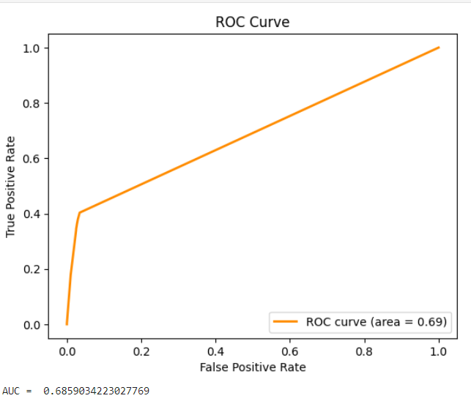
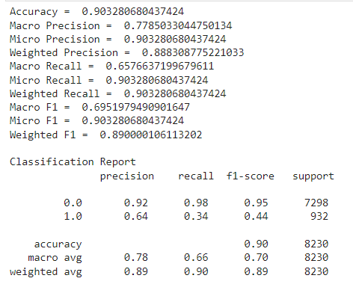
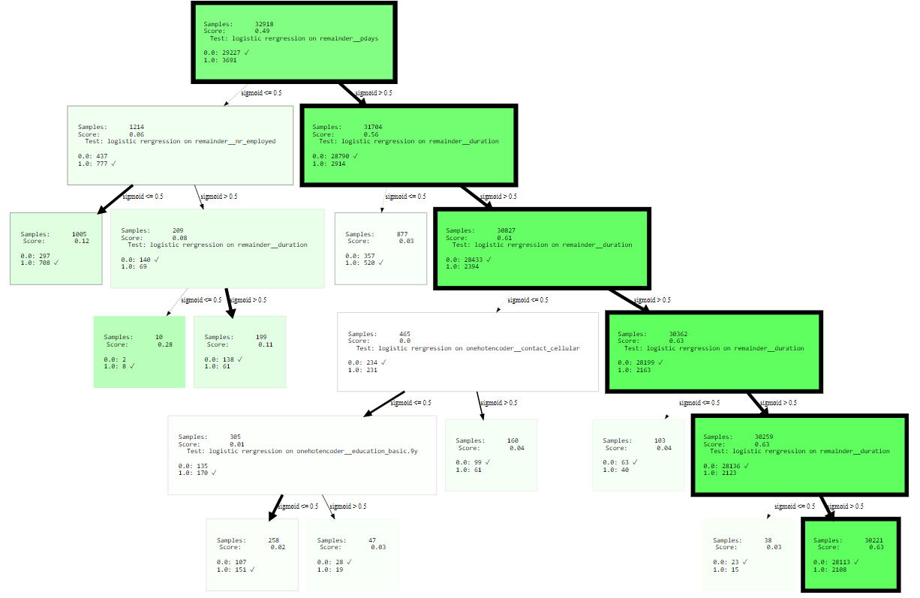
Dataset 3 (One Hot Encoded Data): Single Split
Train Accuracy: 0.9068290904672216
Test Results:
Tree Visualization:

Slide 25
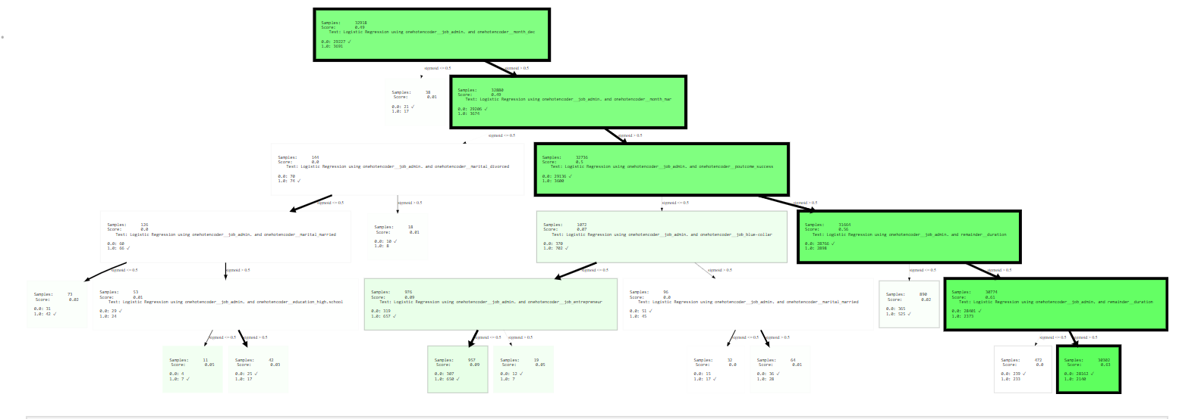
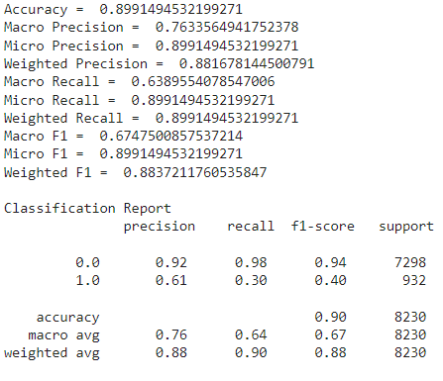
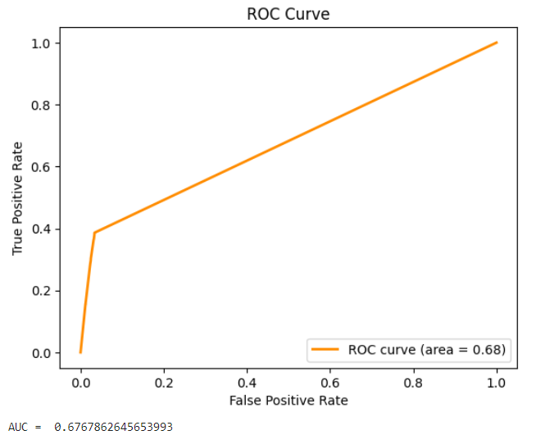
Dataset 3 (One Hot Encoded Data): Pairwise Split
Train Accuracy: 0.903639346254329
Test Results:
Tree Visualization:

Slide 26
Result Analysis
We can observe that even though single and pairwise split give almost similar results for all the datasets under different conditions, but we see that the recall and f1 of pairwise split is comparatively lesser which is also evident in the auc roc curves.
We see that both mean and median modes of null value replacement yield similar results for dataset 1. We use the median mode of replacement for future analysis.
For the third dataset, we see that the one hot encoded data yields slightly better results as compared to simple numerical conversion of categorical data. Since, it is also a more appropriate representation of the data, we use this version of the model for future analysis.

Slide 27



Results using sklearn (default parameters) Decision Tree

Slide 28




Results using sklearn (default parameters) Decision Tree

Slide 29



Results using sklearn (default parameters) Decision Tree

Slide 30
Comparison (Modified Decision Tree vs Sklearn Decision Tree)
Major difference is that in sklearn implementation, it chooses the attribute with the best entropy measure/ gini index and calculates the information gain for each sample. Based on that, it distributes the data accordingly in the child nodes.
In our implementation, the tree does looks for the best attributes for the node, but the internal division of samples take place on the basis of the logistic regression values for the node. The same can be observed from the trees given above too. Goal is to apply logistic function with one feature and 2 features and check metrics like info gain and decide the best feature to split. The depth of the resulting tree maybe less and the rules more interpretable.
As a result the hyperparameters for max depth and the minimum number of samples per leaf have not been fine-tuned much for each different tree.

Slide 31



Postprocessing Steps (K Fold)
Dataset 1:We observe that the overall accuracy for single attribute split is better. The precision offered by the pairwise attribute split is slightly better but that is at the cost of low F1 and recall.
Dataset 2:We observe that single attribute split performs better overall in terms of all the metrics as compared to the pairwise attribute split.
Dataset 3:We observe that even though there is not much difference between the two models but the single split attributes slightly outperforms the pairwise split model.

Slide 32



Postprocessing Steps (Statistical Tests)
Tests Selected:
t test
wilcoxon test
mann whitney u test
kruskal wallis test
chi squared test
Null Hypothesis:
‘model1 and model2 are the same’
Interpretation:
Given the close results for each of the three models, these tests could not reject the null hypothesis in any of the cases, thus we mentioned that the test fail to reject the null hypothesis.
Please note that this does not mean that the models are same, it’s just that the tests failed to distinguish between them for the p value < 0.05, that is confidence interval of 10%.

Slide 33
References
Medium Article (Andrzej Szymanski, PhD) - Resource Material Provided
ListenData Article (Mr. Deepanshu Bhalla) - Weight of Evidence
scikit-learn - user guide for understanding implementation of the different functions
Medium Article (Mr. Ric. Hard) - Resource Material Provided
seaborn - user guide for understanding implementation of the different functions
pandas - user guide for understanding implementation of the different functions
scipy - user guide for understanding implementation of the different functions
LogitTree
Decision Tree From Scratch
HDTree
Classroom Slides and Class notes
The models for both our implementation and the ones obtained from the sklearn library are saved in the models folder. They can be loaded in the same object to make the predictions on the dataset.

